Slide 1
Software Engineering Lab CS 1566
Miss. Minakshi Roy
Assistant Professor, Dept. of CSE

Slide 2
OBJECTIVE
Provide a scope to students where they can solve small, real life problems.
To gain practical experience with some software engineering methodologies, methods and supporting tools.

Slide 3
Software
Software is a general term for the various kinds of programs used to operate computers and related devices. (The term hardware describes the physical aspects of computers and related devices.)

Slide 4
Software Development Life Cycle
Each process model follows a particular life cycle in order to ensure success in process of software development.
E.g. Waterfall model, incremental model, V-model, iterative model, RAD model, Agile model, Spiral model, Prototype model etc..

Slide 5
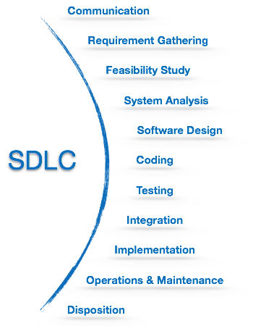
Fig 1: Phases of SDLC
Notes:
5

Slide 6
Requirement Gathering
Gather the requirements regarding the software you are going to develop through various sources.
Best source will be the end user for whom you will be developing the actual product.

Slide 7
Software Requirement Specification - [SRS]
A software requirements specification (SRS) is a document that captures complete description about how the system is expected to perform.
It is usually signed off at the end of requirements engineering phase.

Slide 8
Contents of SRS
Introduction
Purpose
Scope
Definitions
References
Overview
General Description
Product Perspective
Product Functions
User Characteristics
General Constraints
Assumptions and Dependencies

Slide 9
3. Specific Requirements
3.1 Functional Requirements
3.1.1 Func Req 1
3.1.1.1 Introduction
3.1.1.2 Inputs
3.1.1.3 Processing
3.1.1.4 Outputs
3.1.2 Func Req 2
…
3.2 External Interface Requirements
3.2.1 User Interface
3.2.2 Hardware Interfaces
3.2.3 Software Interfaces
3.2.4 Communication Interfaces
3.3 Performance Requirements
3.4 Design Constraints
3.4.1 Standards Compliance
3.4.2 Hardware Limitations
3.5 Attributes
3.5.1 Security
3.5.2 Maintainability
3.6 Other Requirements
3.6.1 Database

Slide 10
Design
This phase begins when the requirements are well understood.
2. You need to draw various diagrams, decide which technology to use for development, resources, Dead Line (estimated time), etc.

Slide 11
Function oriented Vs Object oriented Design
Function oriented Design: DFD (Data flow diagram)
Object oriented Design: Class diagram, Use-case diagram and Object diagram

Slide 12
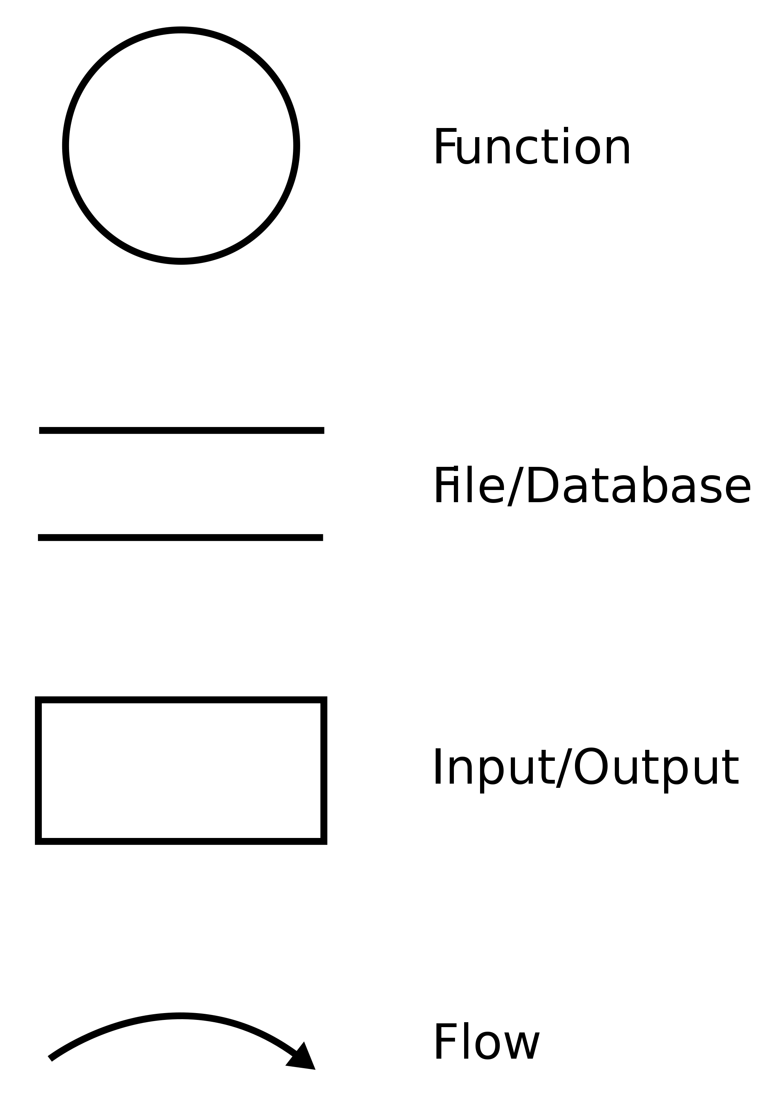
DFD Notation

Slide 13
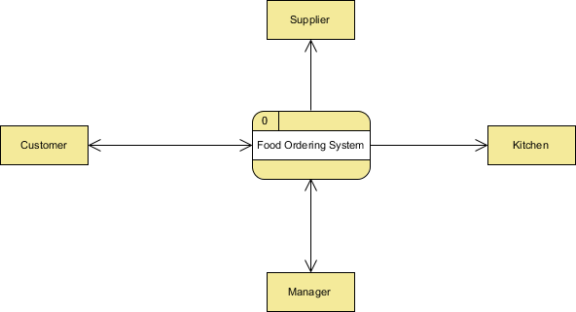
Data Flow Diagram: Examples - Food Ordering System 0 level DFD

Slide 14
Development or Coding
This is the phase where you actually develop the product.
Code is written based on the decision taken in Design phase.
Developers perform Unit Testing and Integration testing to ensure everything is working fine.
Code gets reviewed by Sr. members in the team, and once the development is completed, the product is sent forward for testing.

Slide 15
Testing
The developed product is tested by testers (QA Engineers).
The go for both positive (as per requirements) as well as negative (how to break the product, motto is to find flaws) testing.
If defects are found the product is resent to the development team to fix it. Once the defect gets fixed testers check it again and perform regression testing( testing the whole product).
Once all is good, the product will become ready to handover it to client.

Slide 16
Deployment/Maintenance
Once all the above phases are completed, the product is installed on end users/clients machine.
And in future if end user/client faces some issues maintenance done by the organisation who developed it.

